Slide 1
The Importance of Inclusive Play
Playcraft Systems
Presents

Slide 2
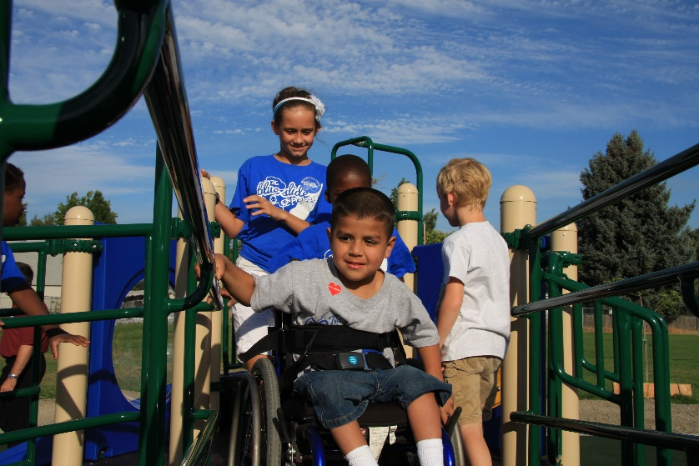
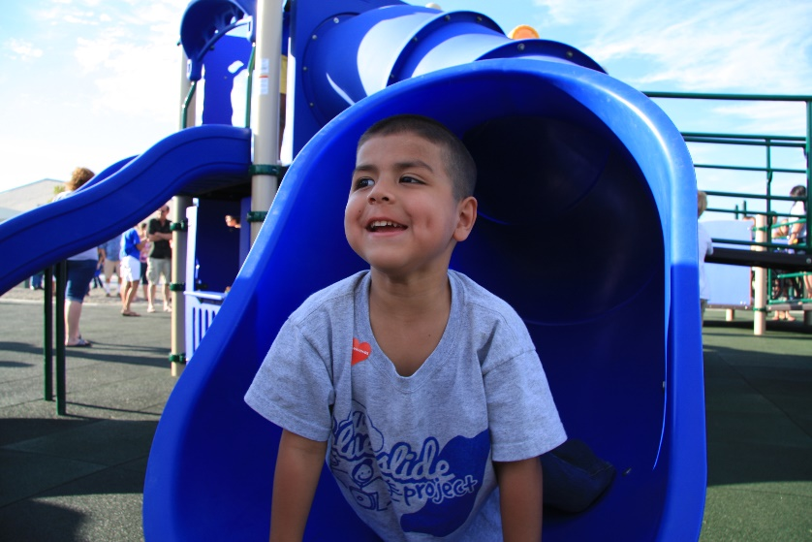
What Does Inclusive Mean?
“including everyone” – Merriam-Webster Dictionary
  Especially, allowing and accommodating people who have historically been excluded
Inclusive Designs are…
  Welcoming
  Active
  Supportive
  Universal
  Diverse
  Fair

Slide 3
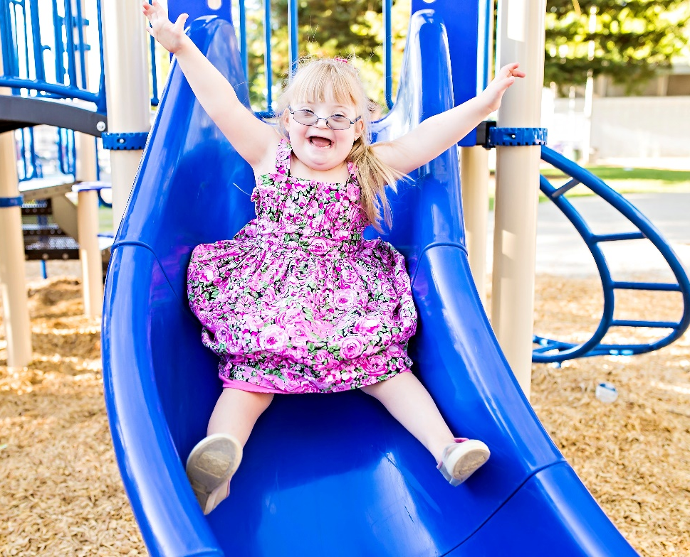
Why Are Inclusive Playgrounds Important?
They provide healthy play experiences for people of all ages and abilities.
They address the diverse needs of society, promote social equity, and create a sense of community
They create awareness, break down barriers to access meaningful play, and foster friendships

Slide 4
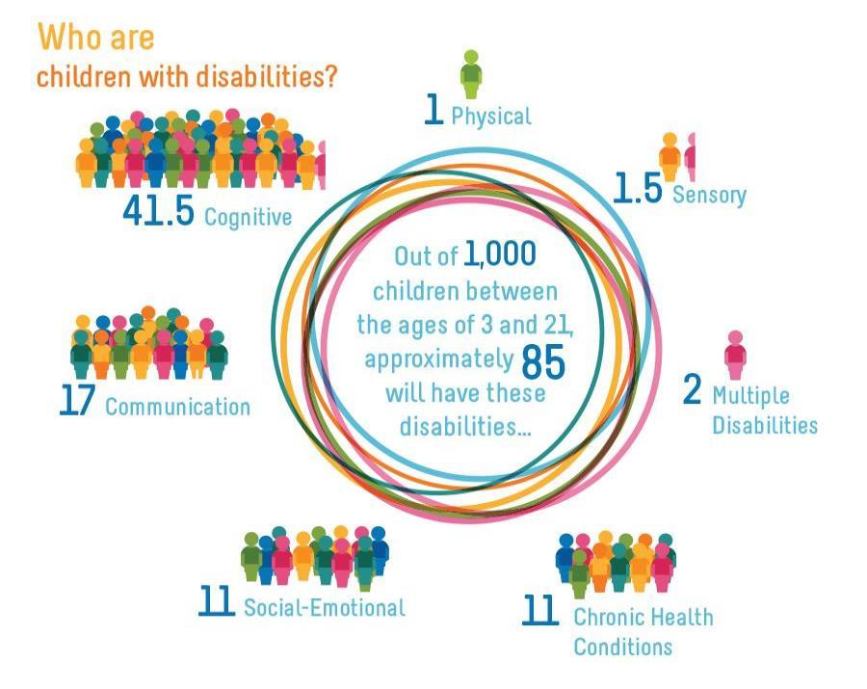

Who are Children with Disabilities?
Notes:
NOTE: This graphic is powerful in helping your customers see how important it is to think beyond just ramps and physical access.
The minimum ADA guidelines help us design for physical access for children with physical disabilities and adaptive equipment, while this is very important and sometimes the most challenging group to plan for, we also think it is critical to consider the rest of the children in our design philosophy for a more universal approach to the playground.
For example, there are many ways we can offer meaningful communication experiences through specific products like talk tubes or through the design of cozy spaces that encourage socialization and communication between friends. Cause and effect activities are very important for children with cognitive disabilities so they can explore, problem-solve, and discover through play.
Often when thinking of creating an inclusive environment the focus is on people who use mobility devices because it is something that visually can be seen. A high quality play environment should consider the needs of people with sensory, communication, social-emotional and cognitive disabilities.
You may want to give an example of a child with autism…every child with autism is different. Some may have physical, social, communication, sensory, or cognitive needs. Some may fall into one of several categories. Hence the need to address all five categories to ensure that the developmental needs of all children are being addressed.

Slide 5
Disability Category- Physical
Relates to issues that affect a child’s motor system. These include orthopedic impairments that involve bones, muscles, and joints or neurological impairments that involve the nervous system, brain, and spinal cord, which make it difficult to move, stand, sit, walk, play, or reach. Some people may use adaptive equipment and/or mobility devices to help them be more independent.
Examples:
  Cerebral palsy, muscular dystrophy, traumatic brain injury, spina bifida, and spinal cord injury

Slide 6
Disability Category- Sensory
Relates to a child’s inability or difficulty gathering, understanding, and processing information from the environment through any of the senses including sight, touch, smell, hearing, taste, vestibular, and proprioceptive.
Examples:
  Hearing & vision related disabilities, sensory processing, and Autism Spectrum Disorder

Slide 7
Disability Category- Communication
Relates to difficulties a child has communicating verbally due to limited comprehension, use of language, and/or oral motor development. Communication consists of expressive language (what you say) and receptive language (what you understand).
Examples:
  Speech, voice, and language disabilities, Autism Spectrum Disorder

Slide 8

Disability Category–Social-Emotional
Relates to a child’s inability to effectively manage behavior which may result in social or emotional outbursts or reactions to situations, or cause difficulty interacting with others in developmentally appropriate ways.
This includes:
  Emotional depression, bipolar, anxiety, PTSD, oppositional defiant disorder, conduct disorder, and Autism Spectrum Disorder.

Slide 9

Disability Category- Cognitive
Relates to a child’s difficult in processing information, reasoning, comprehension, memory, expressing information/emotions, and/or ability to control attention or impulses.
Examples:
  Intellectual or developmental disability, learning disability, Down Syndrome, Autism Spectrum Disorder, Attention Deficit Disorder, and Attention Deficit Hyperactivity Disorder

Slide 10
Clarifying Terminology
The needs of individuals with disabilities have specifically been considered in the design process.
The minimum standard required by law.
Accessible Design
Notes:
NOTE: These slides are to help you create a dialogue about the importance of inclusion and the difference between accessibility and universal design. Remember access does not guarantee inclusion. It is not one in the same. Play environments may be accessible, yet not usable to everyone. Usability is the key to universal design.
Through no fault of their own, opportunities for independent play may be less available to people with disabilities as a result of barriers in the play environment. These barriers may be physical barriers to access or social barriers to participation.
The Americans with Disabilities Act Accessibility Guidelines from Play Areas require the removal of ‘physical barriers to access’ in play environments. These are the minimum requirements.
The term accessibility usually brings to mind issues of access to a space for people with physical disabilities. While this is certainly critical, if access is the sole consideration, the result may not allow equitable participation, and may not consider the needs of the community as a whole.
Creating an accessible play environment helps provide physical access to the space. While this is very important, we are also very focused on what happens once we get you there.
Moving Beyond Minimum Accessibility- Universal Design is an approach to designing products, services, and environments to be usable by as many people as possible, to the greatest degree, regardless of their ability.
It is important to understand that play environments may be accessible, yet not usable to everyone! .

Slide 11
Clarifying Terminology
Universal Design
Defined as “the design of products and environments to be usable by all people, to the greatest extent possible, without the need for adaptation or specialized design.”
  Ron Mace, 1988
Accessible Design
Notes:
The other approach that was evolving within in the same time was “universal design.” It is a broader concept than “accessible design” and considers designs that benefit all users, not just people with disabilities. The late Ron Mace was the chief proponent of Universal Design, which began with a growing concern that providing “accessible design” may sometimes result in segregated solutions that fail to support the integrated participation of people with disabilities. It is an orientation to design where designers strive to incorporate features that make each design more “universally” usable. Universal design is not tailored to the individual but to think more broadly about usability, rather than focusing exclusively on the requirements of the ADA.
For example, limiting access points into the play area to the minimum requirement of one entry point, where other children can access at any point. This is example of a potentially stigmatizing effect known as the “handicapped entrance.” A universal design approach to this focusses on ensuring that all entrances accommodate all users and allow groups, including people using wheelchairs, walkers or with strollers, to enter together.

Slide 12
Clarifying Terminology
Inclusive Design
Inclusive playground design is consistent with the concept of universal design and recognizes everyone’s right to fully participate and contribute to meaningful play, reaping the lifelong development physical and social benefits of inclusion.
Universal Design
Accessible Design
Accessible Design

Slide 13
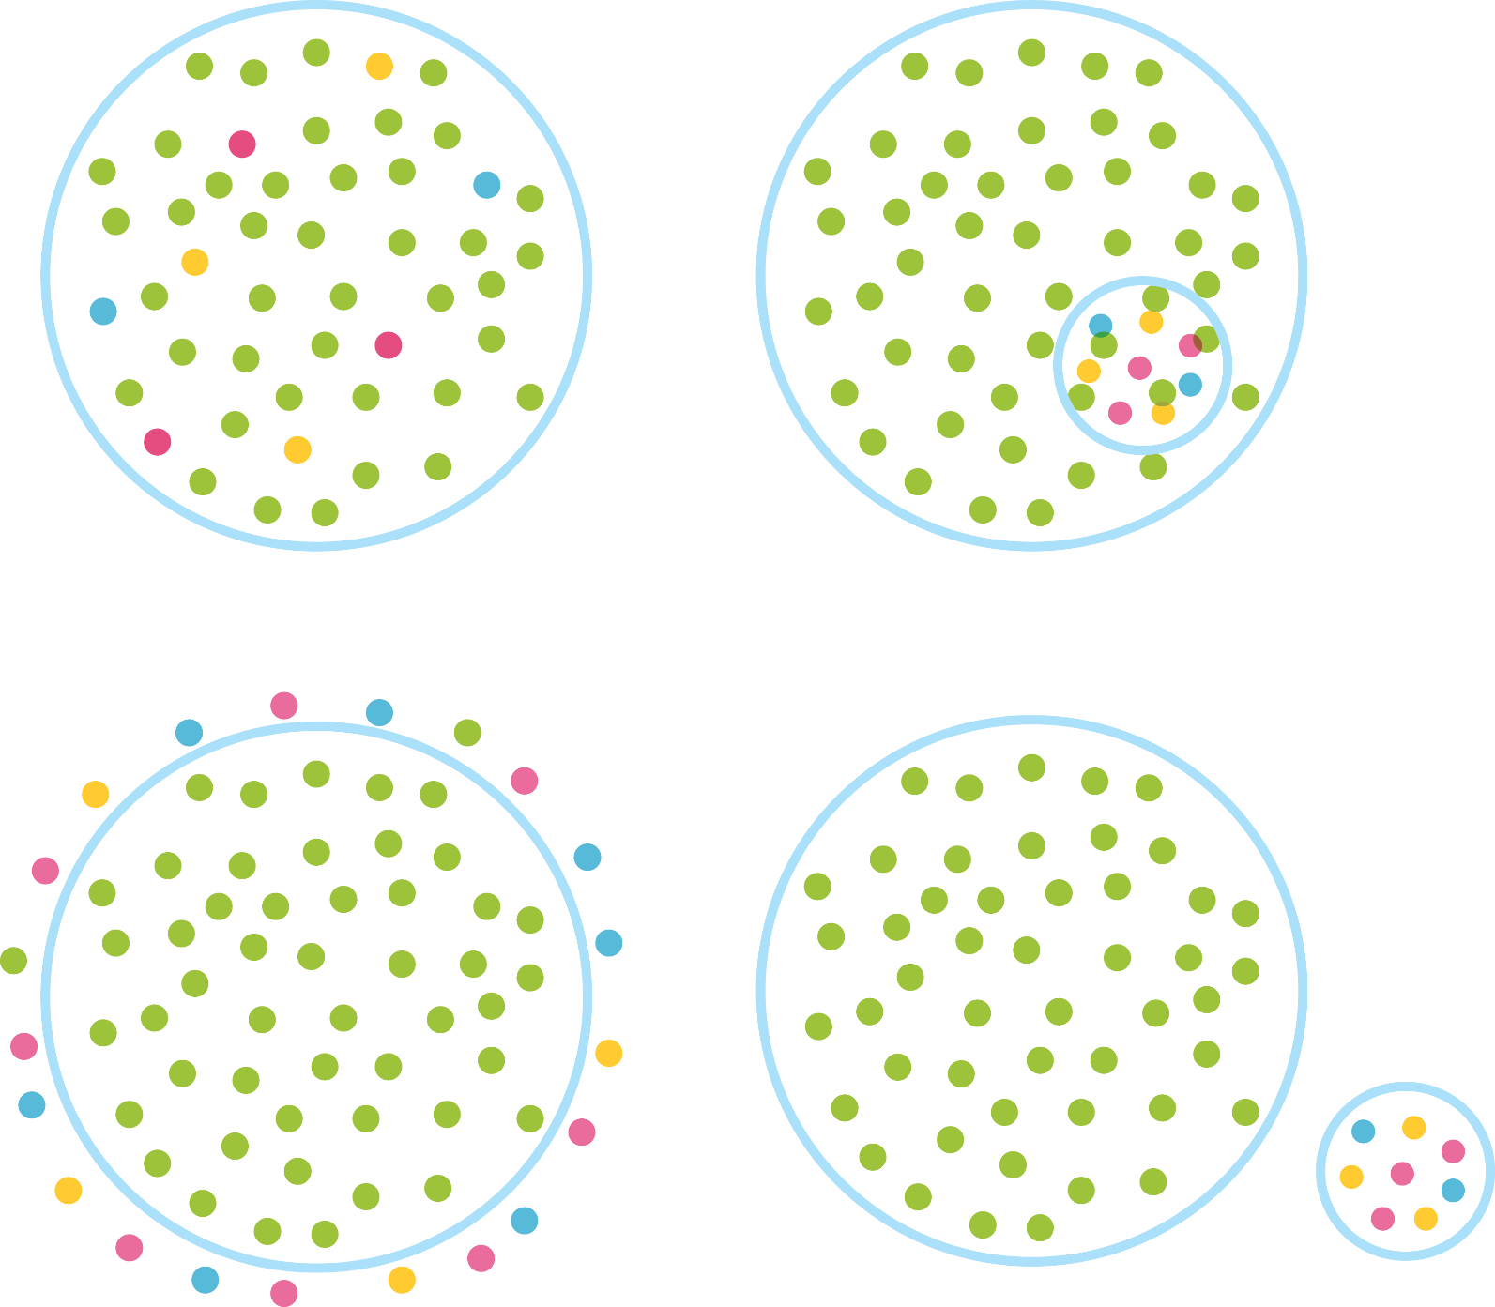


Access Does Not Guarantee Inclusion
Universal Design
Exclusion
Segregation
Integration
Inclusion
Notes:
Apparent exclusion or lack of diversity in play and recreation spaces is doubtfully ever intentional. When inclusion is not achieved, society as a whole may not benefit from the addition and rich experiences of those who are most affected and who have a lot to offer. The term accessibility usually brings to mind issues of access to a space for people with physical disabilities. While this is certainly critical, if access is the sole consideration, the result may not allow equitable participation. Inclusion includes access, a much wider range of considerations must be adopted to create a meaningful experience where all have equitable participation in the environment with the people there. Individuals with disabilities desire and need to play alongside their peers, family, and community members. They should not be excluded or segregated, or even integrated into a part of the play environment. When inclusion happens, people of all ages and abilities have access to both physical and social play experiences that are equitable and achieved at the greatest extent possible.
Proximity does not guarantee participation.
Inclusive play environments encourage children of all abilities to play together, allowing them to develop an understanding and appreciation of each other’s strengths and challenges. This interaction is critical toward creation of stronger sense of community and helps facilitate personal experiences and build lifelong positive outcomes.
People with disabilities wish to play alongside their peers, feel the camaraderie of a group, experience the pride of physical and social achievements, reach their full potential, and cement a strong connection to their community through the experiences encountered while at play.

Slide 14
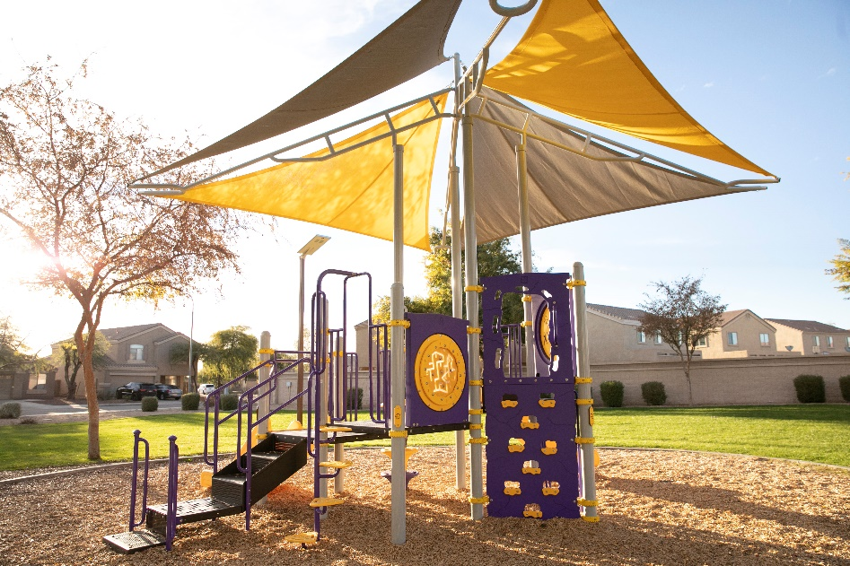
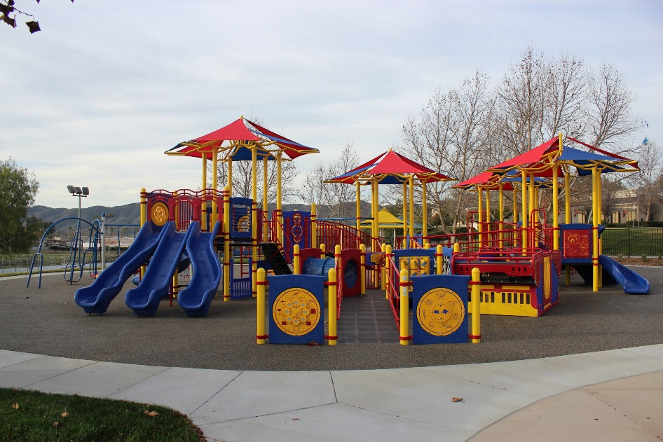
Access Does Not Guarantee Inclusion
ADA Compliant Design
Inclusive Design
Notes:
Accessibility Provides a Critical Foundation for Inclusion to Occur. You can’t have one without the other.
An accessible play environment has considered accessible routes of travel outside and inside the play environment. The structure has a transfer intended for an individual using a mobility device to transfer out of their wheelchair and use their arms to access the platforms. A variety of ground level play components have to available, etc.
In an inclusive design, a diverse offering of activities are present that address the developmental needs of everyone. It is not a playground designed solely for children with disabilities. An inclusive environment is not just a ramped play structure- it should implement design strategies that address the physical, social-emotional, cognitive, communicative, and sensory needs of all children, including those with disabilities.

Slide 15
Foundations of Inclusive Play
Inclusive design is a way of creating physical spaces and products to address the inherent diversity of people. It introduces flexibility, choice, and accommodating features to the world that we all inhibit.
Every child has the right to play, but not every child has the opportunity to do so in their local park or school. An inclusive playground eliminates the barriers, encouraging personal growth along with the creation of new friendships.

Slide 16
Inclusive Design Strategies
Create Access
  Access to and around the playground is extremely important. Make sure to include accessible routes, along with surfacing that is accommodating to wheelchairs. Also, getting people to the play space is only part the equation. Ensuring they have equitable play experiences when they arrive is key to success. Consider using ramps and providing ground level play opportunities.
Keep It Simple
  Understanding how to use the play area should be intuitive and easy for all people. Provide sections of play experiences, such as active or passive areas. Include varying color across the playground to organize these areas, along with creating paths to follow.
Add Sensory Elements
  Incorporating activities that provide multisensory experiences with touch, sight, sound, and movement can positively influence the development of the whole child

Slide 17
Inclusive Design Strategies
Encourage Social Exchanges
  Children learn about each other when they communicate and socially interact. Consider ways to encourage communication, cooperation, and for children of all abilities to social interact through games, dramatic play experiences or multi-user components.
Offer Choices
  Thinking about the many ways children play is an important aspect of success. Some children love to jump in the middle of the action, others may prefer to comfortably observe from a cozy spot to bench before joining in the fun. Offer a variety of elements including climbing, upper body events, balancing, swinging, sliding, spinning, rocking, and climbing.
Opportunity For All
  A child deserves to be able to interact with the other kids on the playground and not be limited to certain types of equipment based on their abilities. Provide opportunities for children to engage with one another throughout the design.

Slide 18
Accessible Design Standards
Playground and Site Layout

Slide 19
ADA Standards
Number of Elevated Events | Minimum Number of Ground Events | Minimum Number of Types of Ground Events
1 | N/A | N/A
2-4 | 1 | 1
5-7 | 2 | 2
8-10 | 3 | 3
11-13 | 4 | 3
14-16 | 5 | 3
17-19 | 6 | 3
20-22 | 7 | 4
23-25 | 8 | 4
25+ | 8 | 5
ADA standards are a federal law that must be upheld on all playground designs open to the public
These standards break down the minimum requirements for accessible play features on the design
50% of total elevated events must be accessible

Slide 20
ADA Standards
Number of Elevated Events | Minimum Number of Ground Events | Minimum Number of Types of Ground Events
1 | N/A | N/A
2-4 | 1 | 1
5-7 | 2 | 2
8-10 | 3 | 3
11-13 | 4 | 3
14-16 | 5 | 3
17-19 | 6 | 3
20-22 | 7 | 4
23-25 | 8 | 4
25+ | 8 | 5
Add 1 for each additional 3 elevated events over 25.
Where 20 or more elevated play components are provided, at least 25% must be accessible by a ramp.
If 50% of the elevated play events are accessible by a ramp, and at least three events are of different types, this chart will not apply.

Slide 21
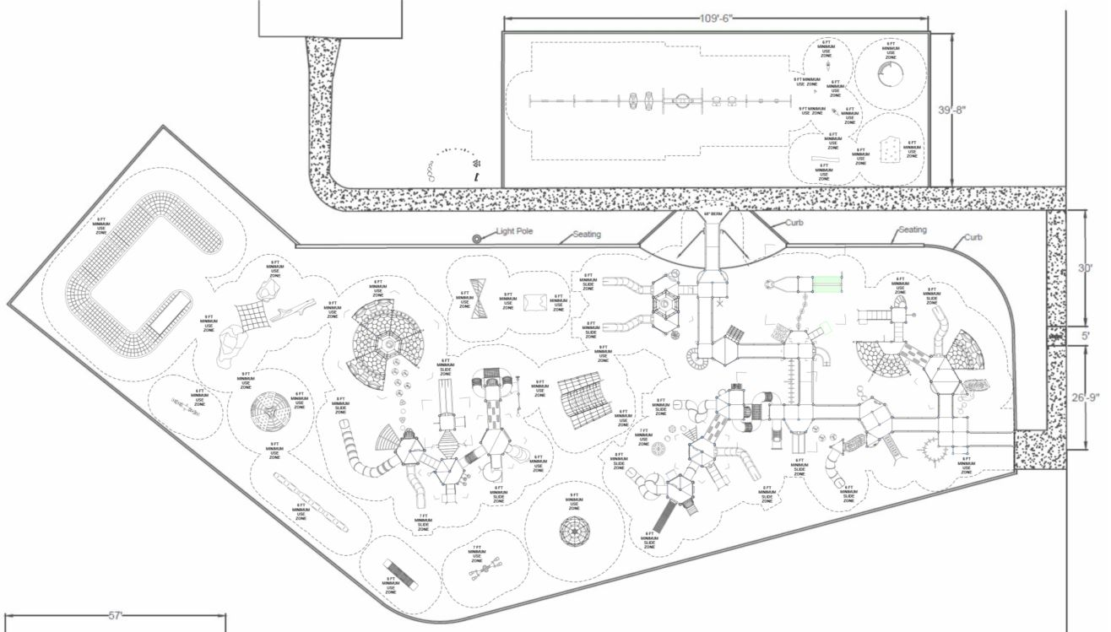

ADA Standards
 | Contains | Required
Elevated Events | 91 | N/A
Accessible | 68 | 23
Ramp Accessible | 32 | 23
Ground Events | 67 | 0
Types of Events | 5 | 5

Slide 22
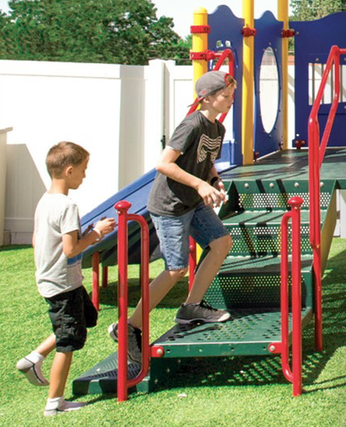
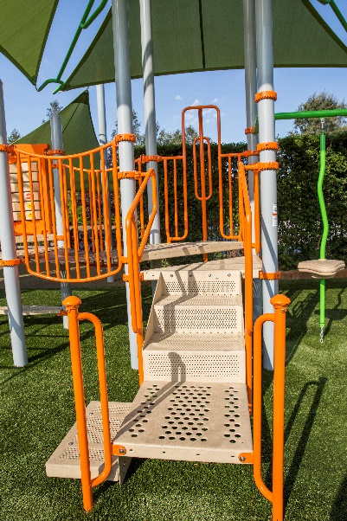
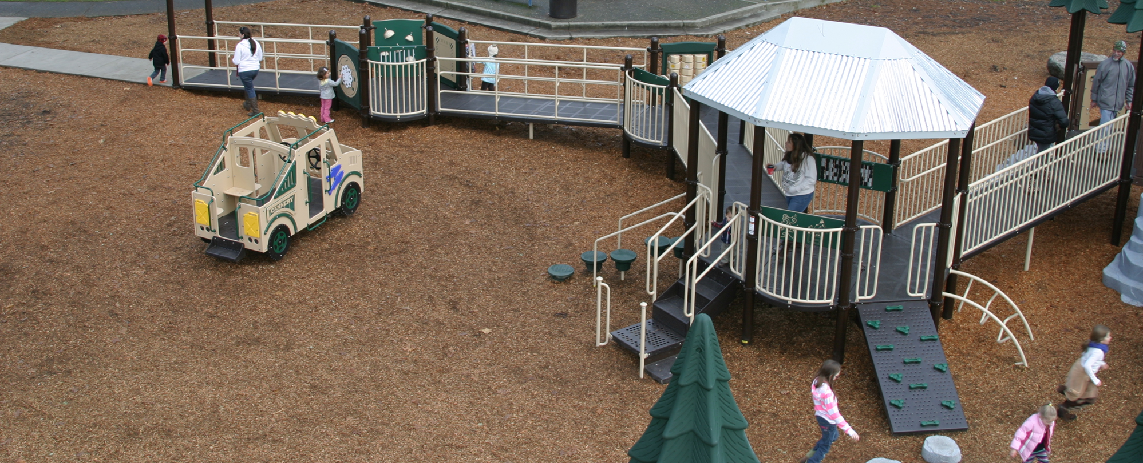
Accessibility
Transfer Station/Point provides a point where a child can easily transfer from their mobility device to the playground
  ADA compliant
Ramps provide diverse users, adaptive equipment, and caregivers access to social and physical play on the structure

Slide 23
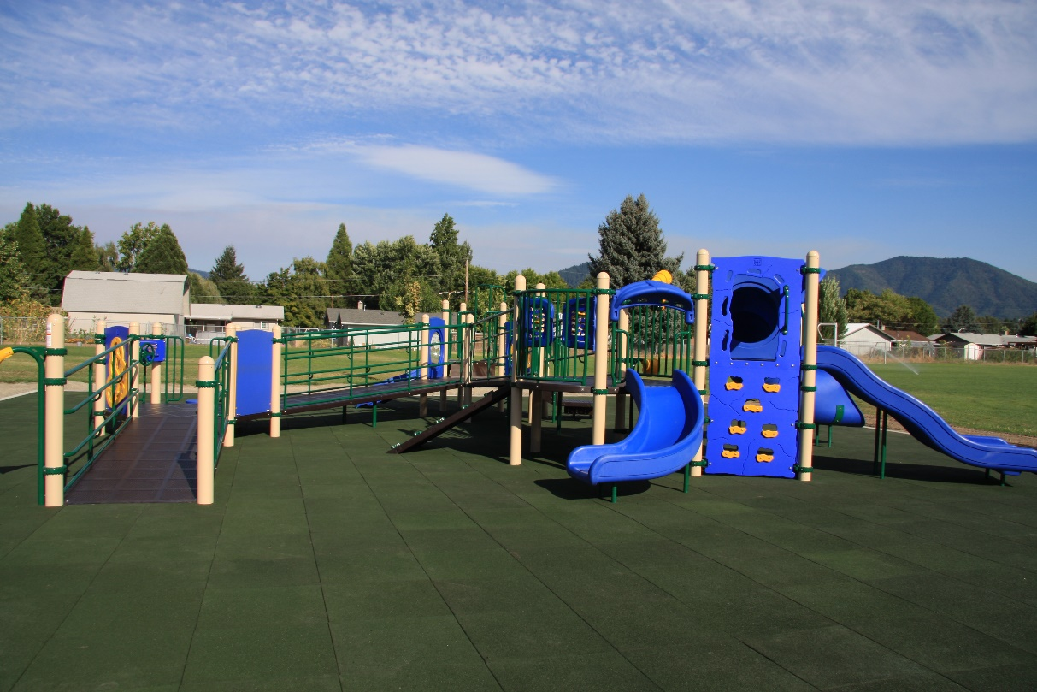
Design Flow
It is good practice to incorporate access/egress points throughout the playground
This looping pattern encourages children to flow through the playground
As an example, wherever you have a slide, locate an access point, such as the transfers point or a climber near by

Slide 24
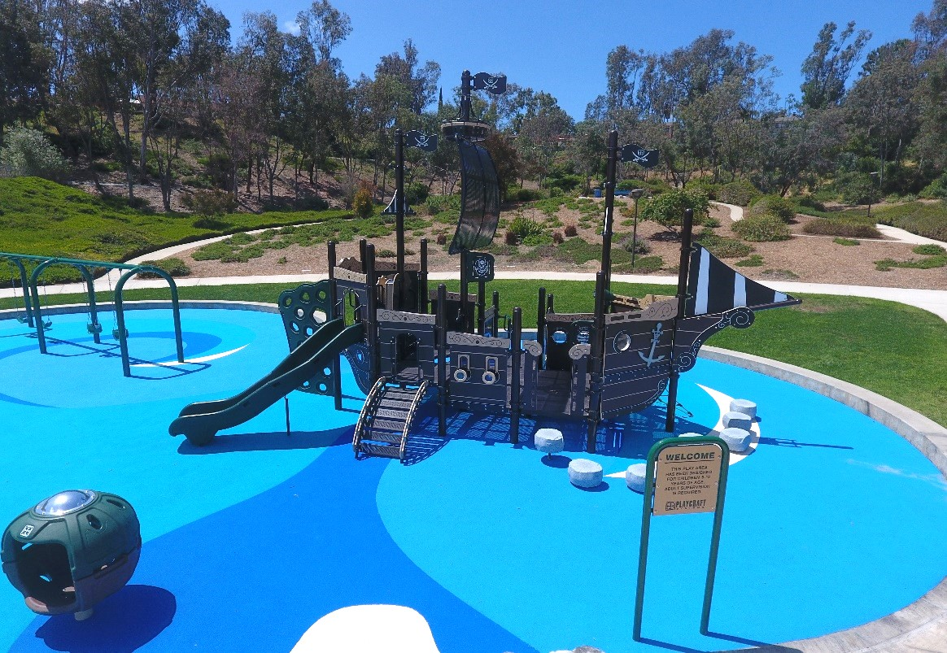
Accessible Routes
Throughout the site, you need to include clear accessible pathways to access the equipment. These pathways should link to ground events, access points, and even slide exits
Without these pathways, the equipment cannot be accessible

Slide 25
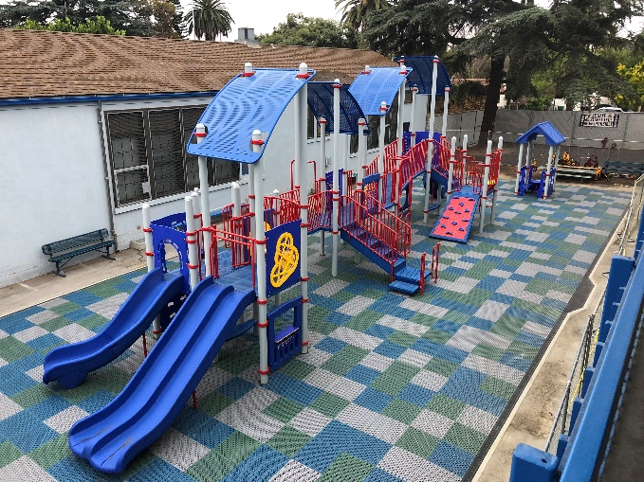
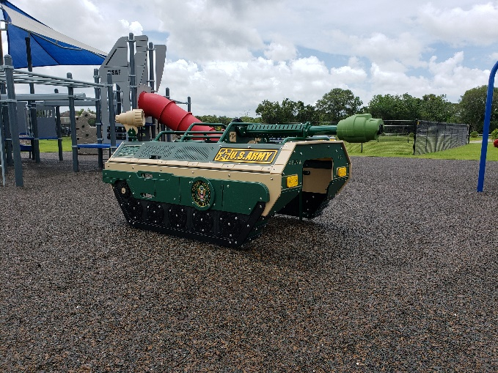
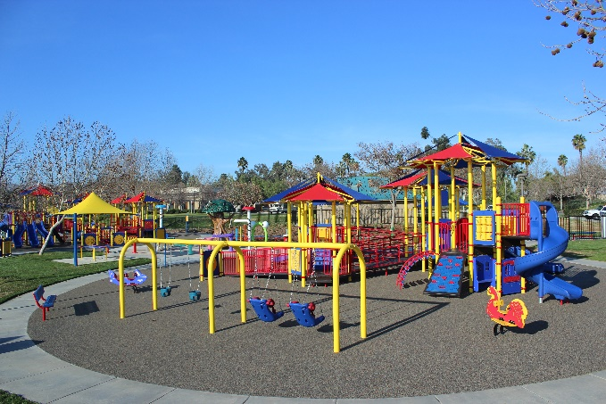
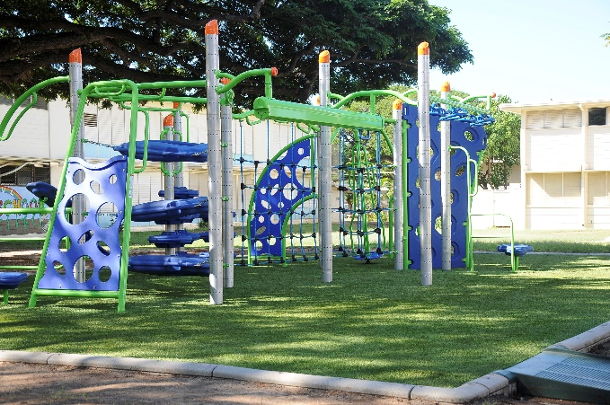
Surfacing
A large factor on any design is the surfacing. Every playground requires compliant safety surfacing that meets critical fall height and ADA standards.
  Engineered Wood Fiber
  Rubber Mulch
  Rubber Tile
  Bonded Rubber Mulch
  Poured-In-Place
  Artificial Turf

Slide 26
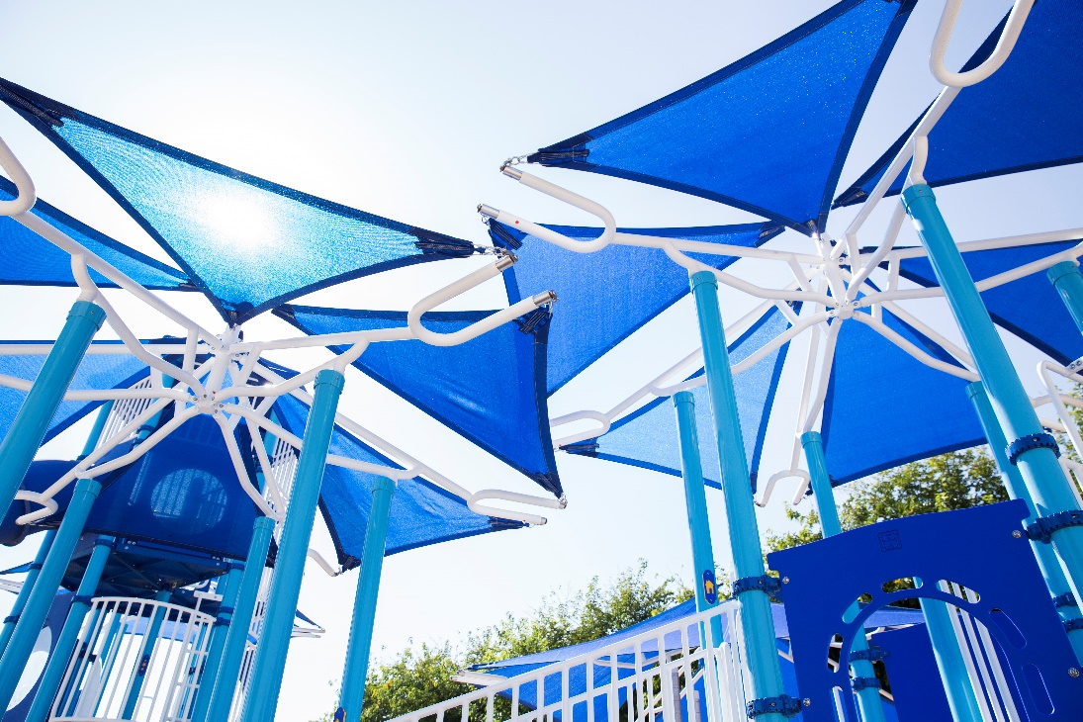
Shade
Shade is a crucial factor for any playground design, especially in areas of direct sunlight and high heat
Including roofs and shades within the design allow the equipment to stay out of direct sunlight, along with providing an area where visitors can cool down

Slide 27
Key Inclusive Design Considerations
Elements to Support the Developmental Needs of All Children

Slide 28
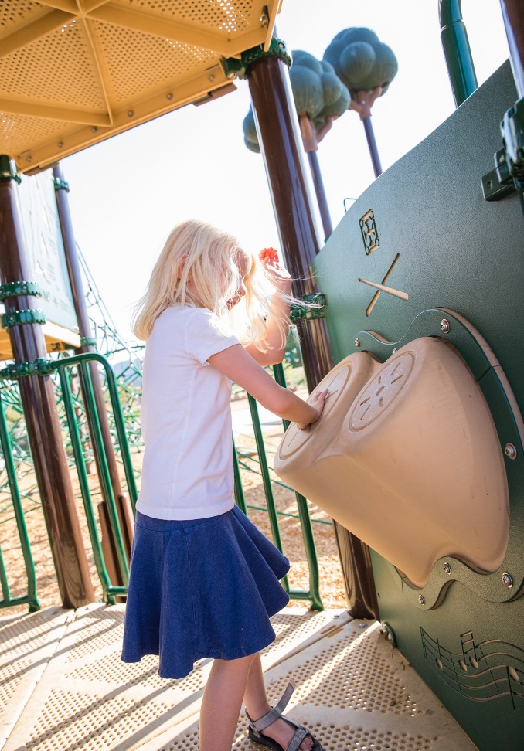
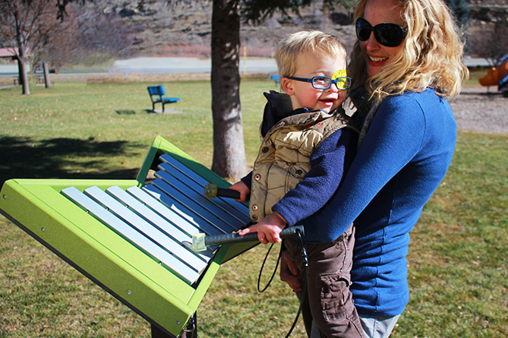
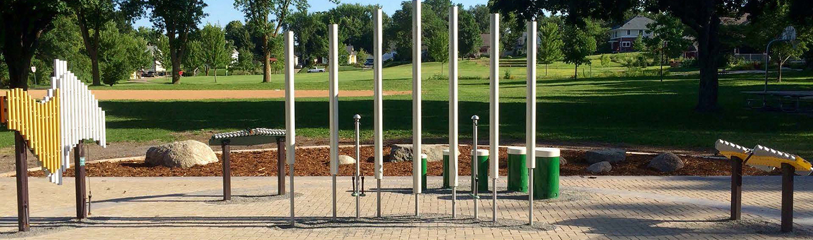
Music
Encourage collaboration, creativity, and age-appropriate activities for multi-generational users at any developmental stage
Musical instruments are great for adding auditory experiences to any design

Slide 29
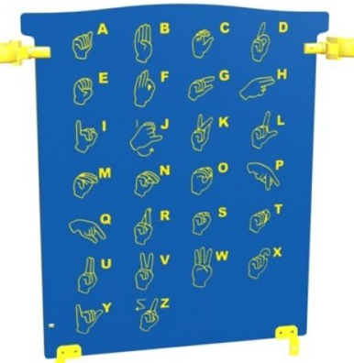
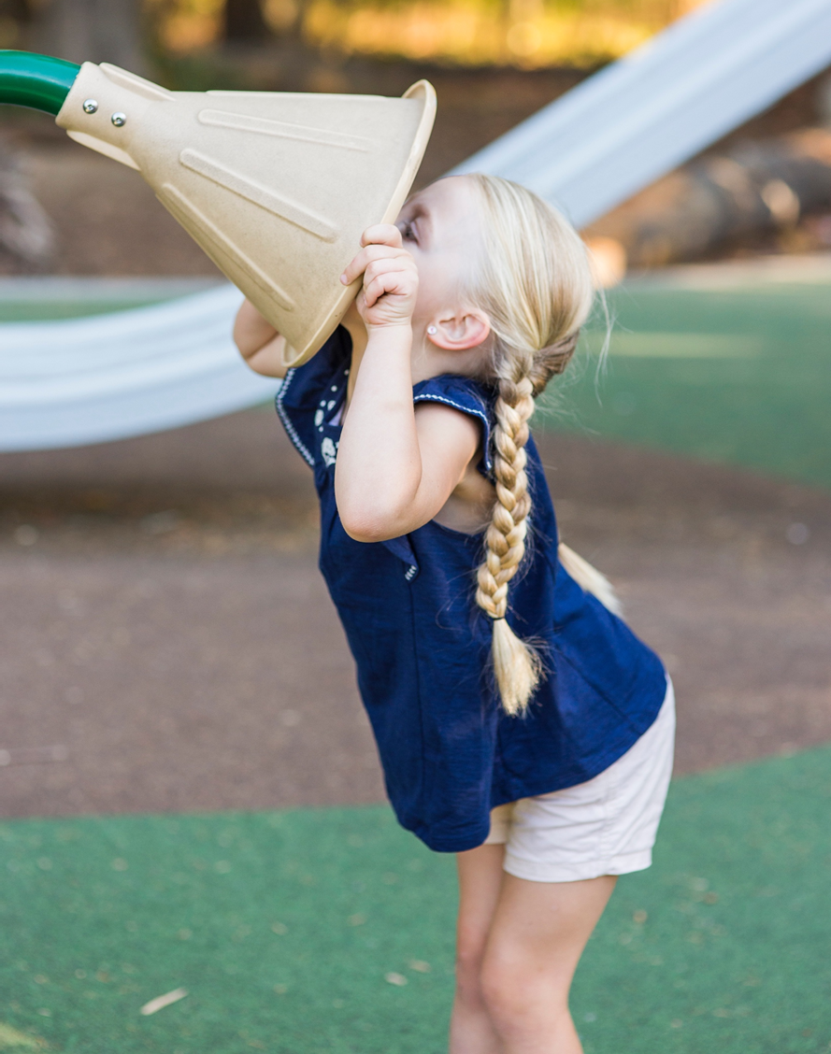
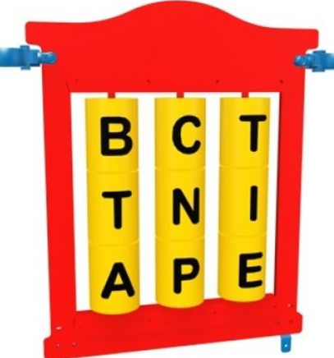
Communication
Support language skill development through motivating, collaborative, and reciprocal activities with friends and caregivers
Include activities that encourage vocalizations or that promote literacy and understanding of language through letters, symbols, or pictures

Slide 30
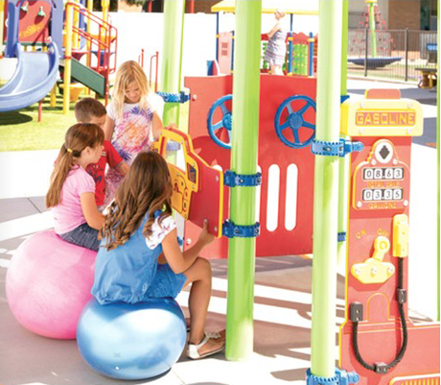
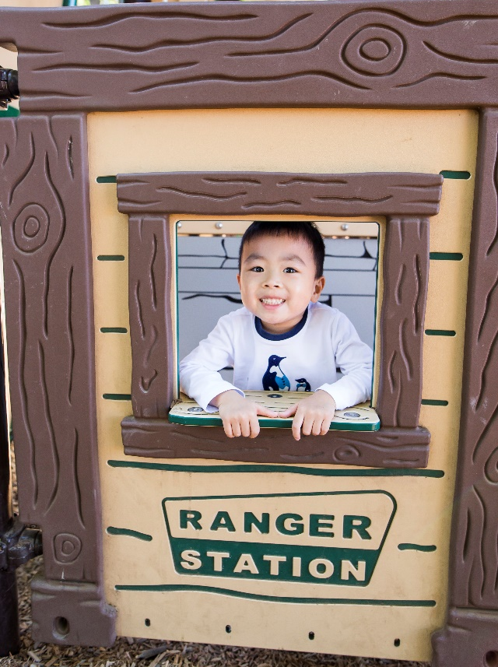
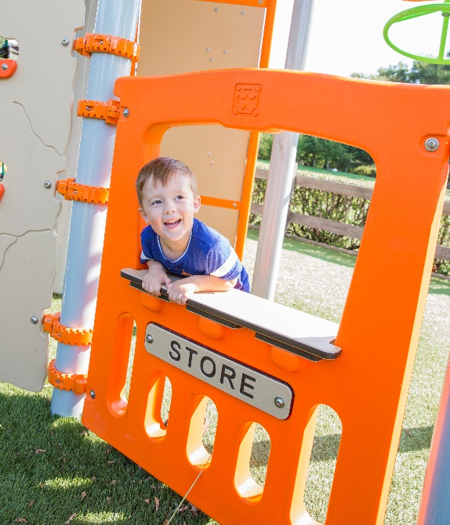
Dramatic Play
Promote imagination, creativity, symbolic thinking and social dialogue through pretend play
Incorporate elements such as steering wheels, telescopes, and playhouses

Slide 31
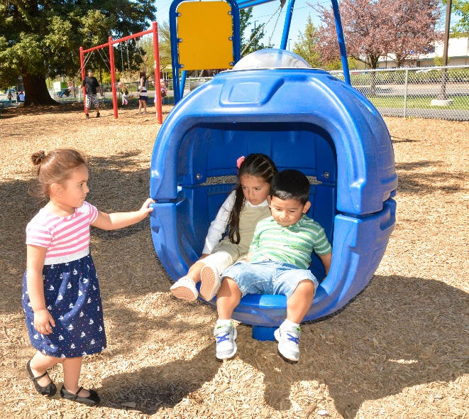
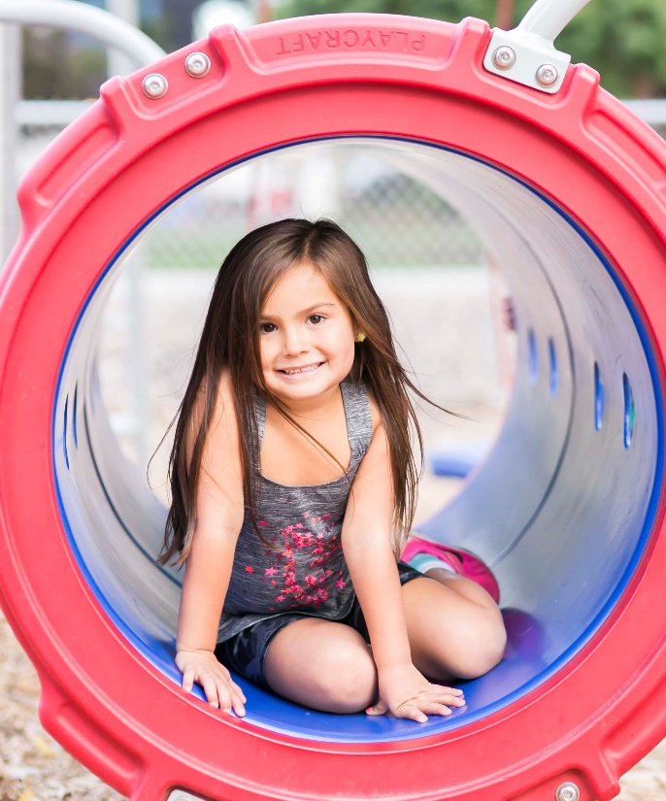
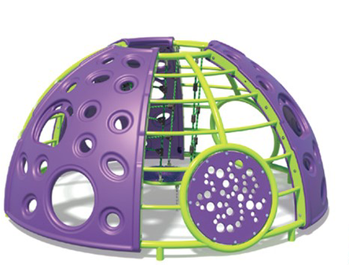
Cozy Spots
Offer quiet or semi-enclosed places where children can seek sensory relief or retreat until they are ready to play
Domes, crawl tubes, and underdeck seating areas positioned away from active play areas can create cozy areas

Slide 32
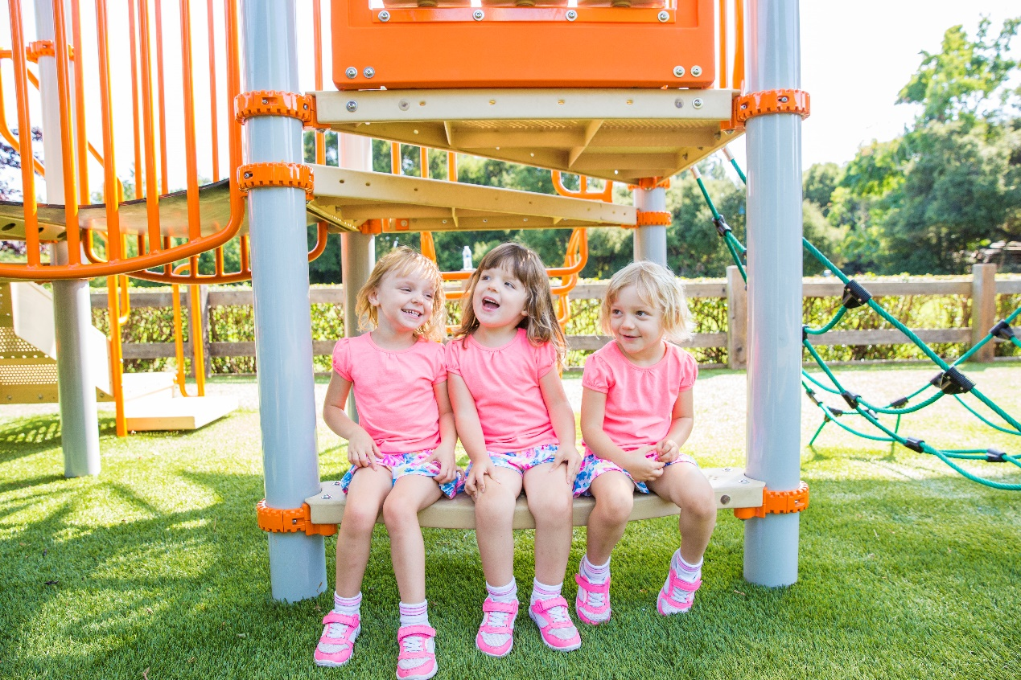
Jump-In Point
Create passive areas for children to observe, gain confidence, and better understand the play activity prior to participating
Position seats or benches adjacent to other activities to help draw children into more active play

Slide 33
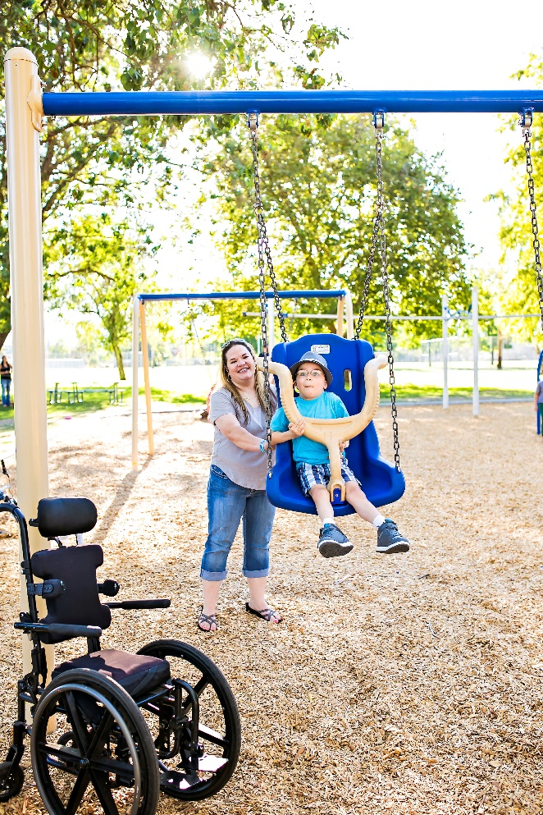
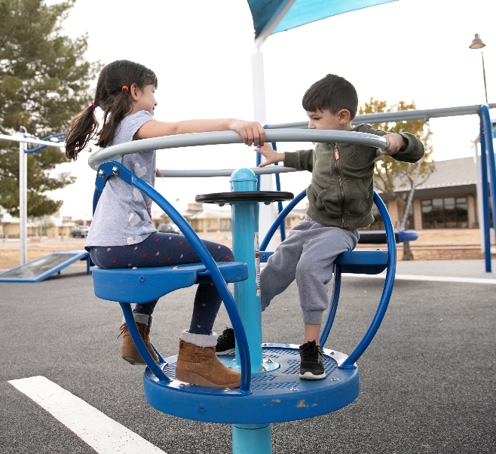
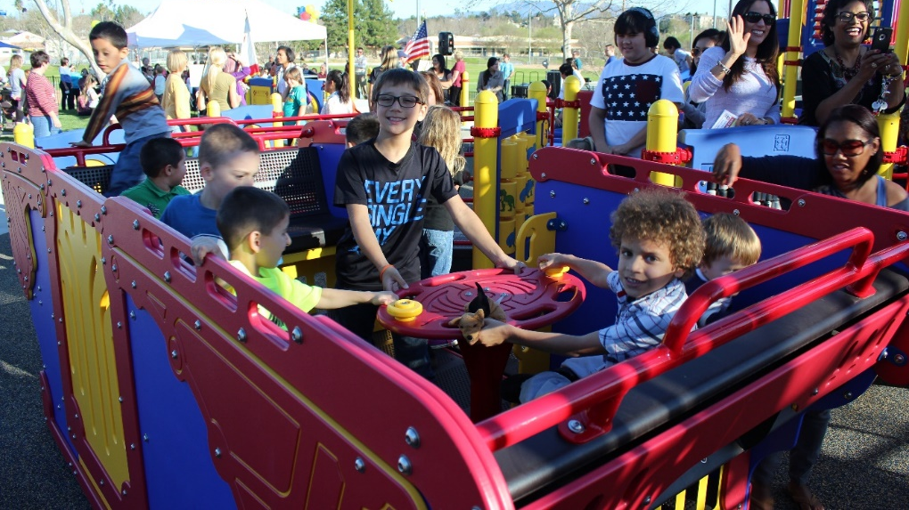
Motion & Movement
Provide sensory-rich motion opportunities through spinning, rocking, and swinging activities
Motion activities help children develop motor control and planning

Slide 34
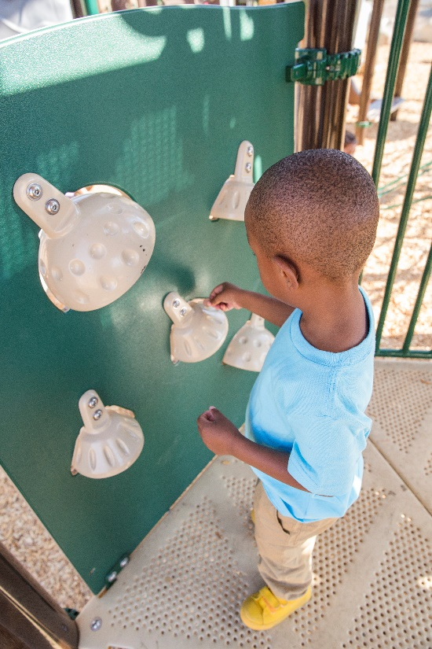
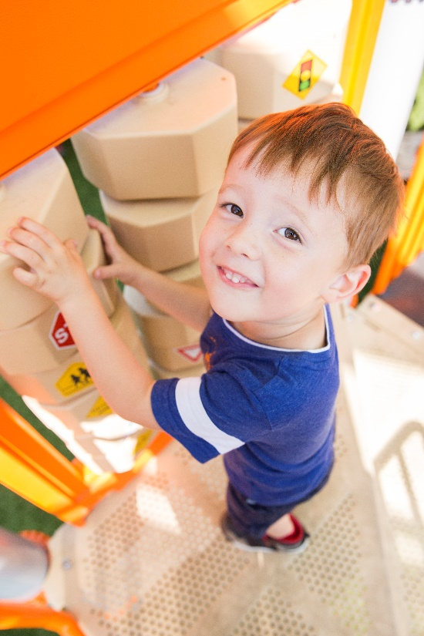
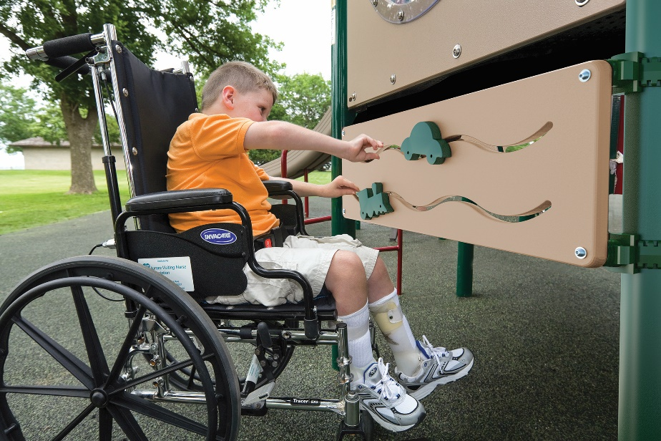
Activity Panels
Provide activities that offer cognitive, social, and sensory benefits on the structure and at ground level
Half activity panels provide space underneath the panel to allow individuals using mobility devices to comfortably reach and approach the activity

Slide 35
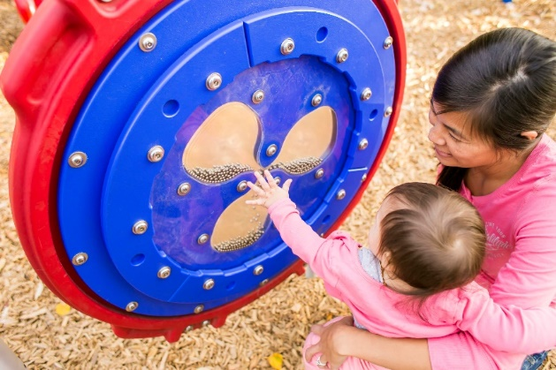
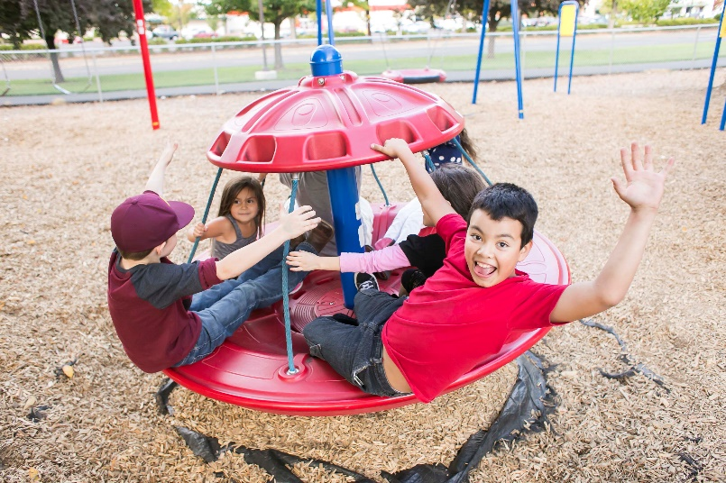
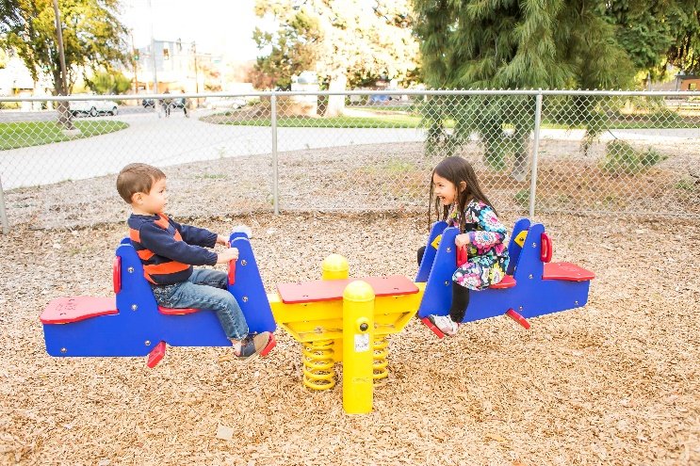
Cooperative Play
Reinforce positive interactions between children through dynamic and fun experiences as they work together to drive the action or engage in the activity.
Examples of cooperative play include social panels, merry-go-rounds and seesaws.

Slide 36
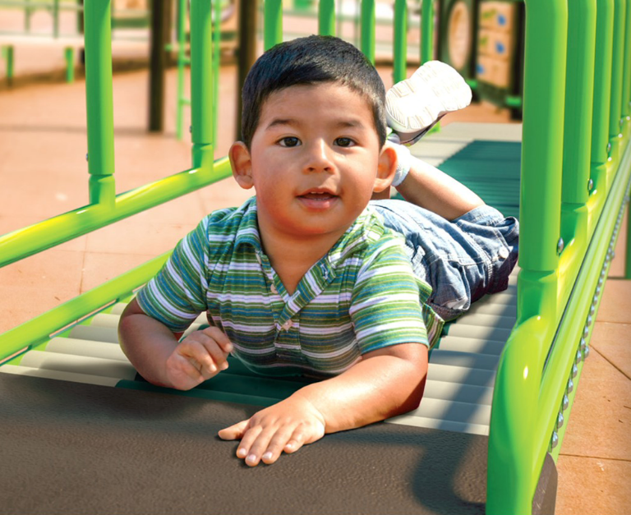
Accessible Upper Body
Offer equitable alternatives to upper body/climbing equipment
Such products include roller tables, therapeutic rings, chin-up bars, and hand cyclers.

Slide 37
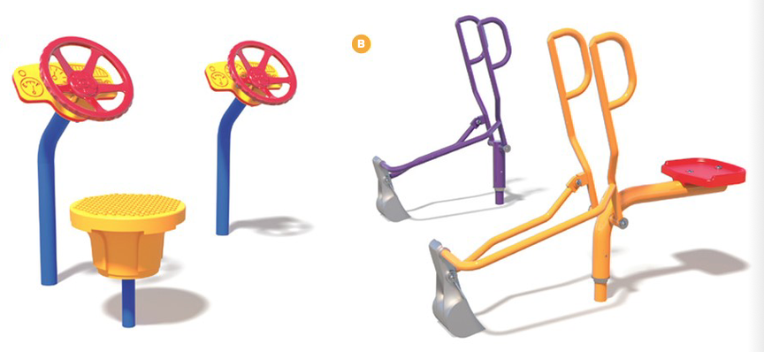
Parallel Play
Ensuring children with and without disabilities can enjoy equitable experiences side-by-side.

Slide 38
Resources
Tools For Your Next Design

Slide 39
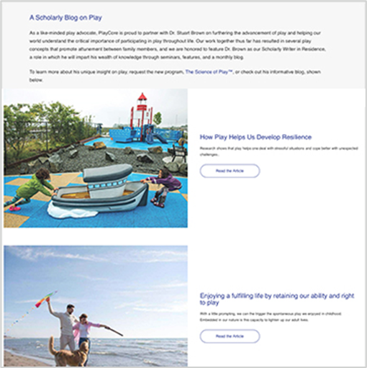
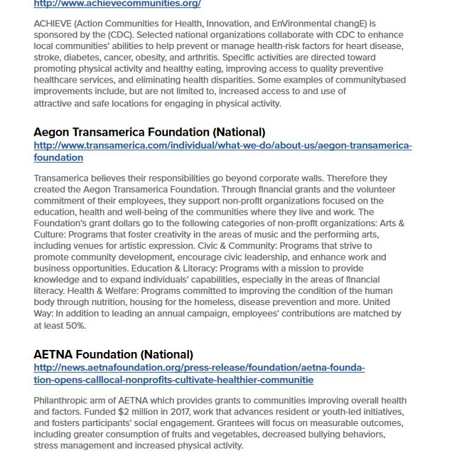
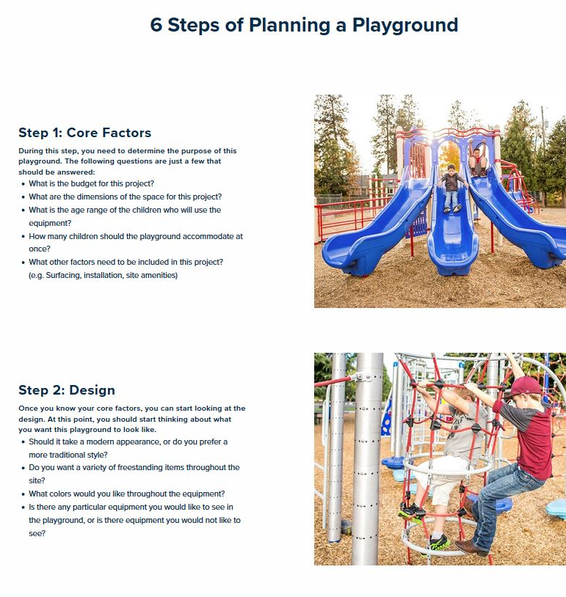
Resources
Dr. Stuart Brown’s Online Blog (https://www.playcore.com/drstuartbrown)
Playcraft’s Funding Guide (https://www.playcraftsystems.com/start-a-project/resources/funding)
Playcraft’s Planning Guide (https://playcraftsystems.com/start-a-project/resources/planning)

Slide 40
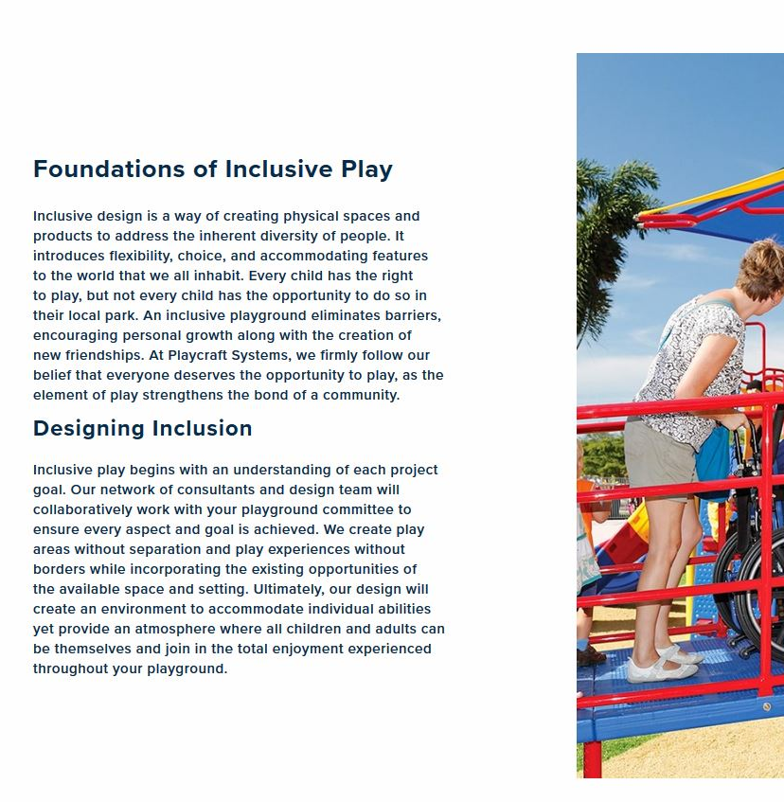

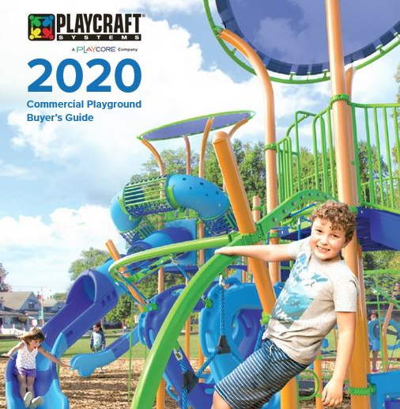
Resources
Playcraft’s Inclusive Play Foundations (https://www.playcraftsystems.com/start-a-project/resources/inclusive-design)
Playcraft’s Color Guide (https://www.playcraftsystems.com/start-a-project/resources/colors)
Playcraft’s Catalog (https://playcraftsystems.com/start-a-project/resources/catalogs-guides)

Slide 41

Webinars
Join PlayCore’s Center for Outreach, Research, & Education for our 2020 Webinar Series. Their credentialed trainers provide evidence-based educational materials and interactive learning experiences to effectively equip attendees with the knowledge and resources to share with their communities.

Slide 42
Webinars
March
  Adult Fitness
April
  CSPAP (Schools)
May
  Bike Parking Standards & Installation
June
  ADA Accessible Pools
  ADA Standards for Accessible Design
July
  Aquatics Inclusive Water Play
August
  Unleashed (Dog Parks)
September
  Strong Foundations
  Nature
October
  Natural Harmony
November
  Health & Wellness
December
  Inclusion Beyond Play

Slide 43
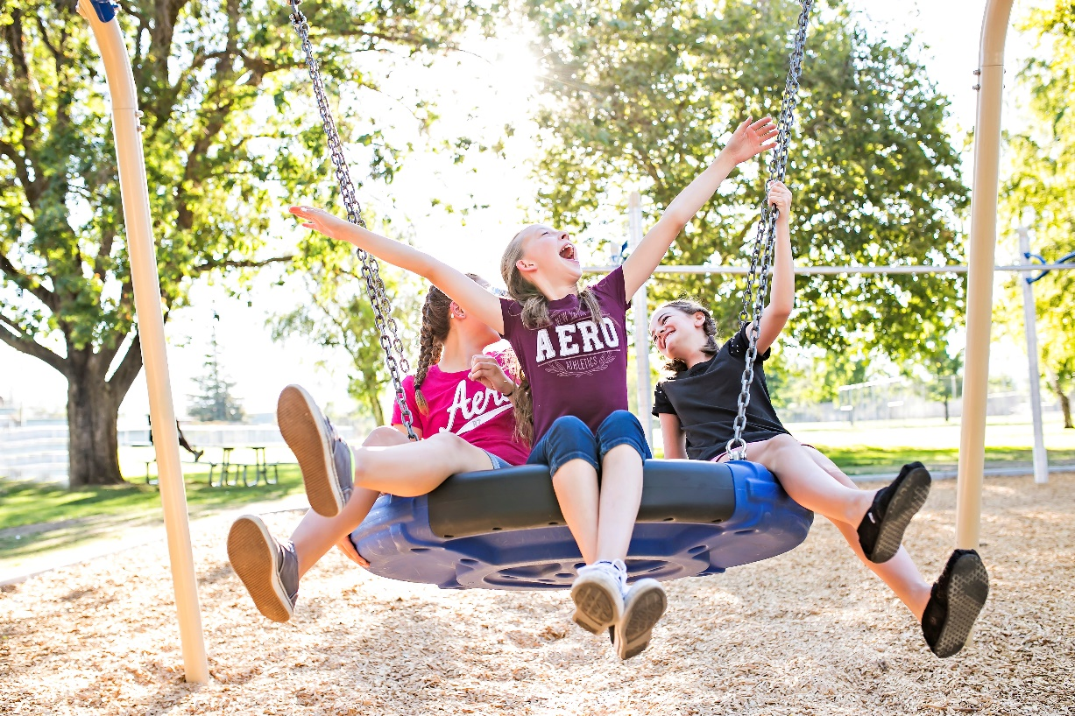
Webinars
To register for one of these webinars, just go to www.playcore.com/events
Registration Code: CRAFT

Slide 44
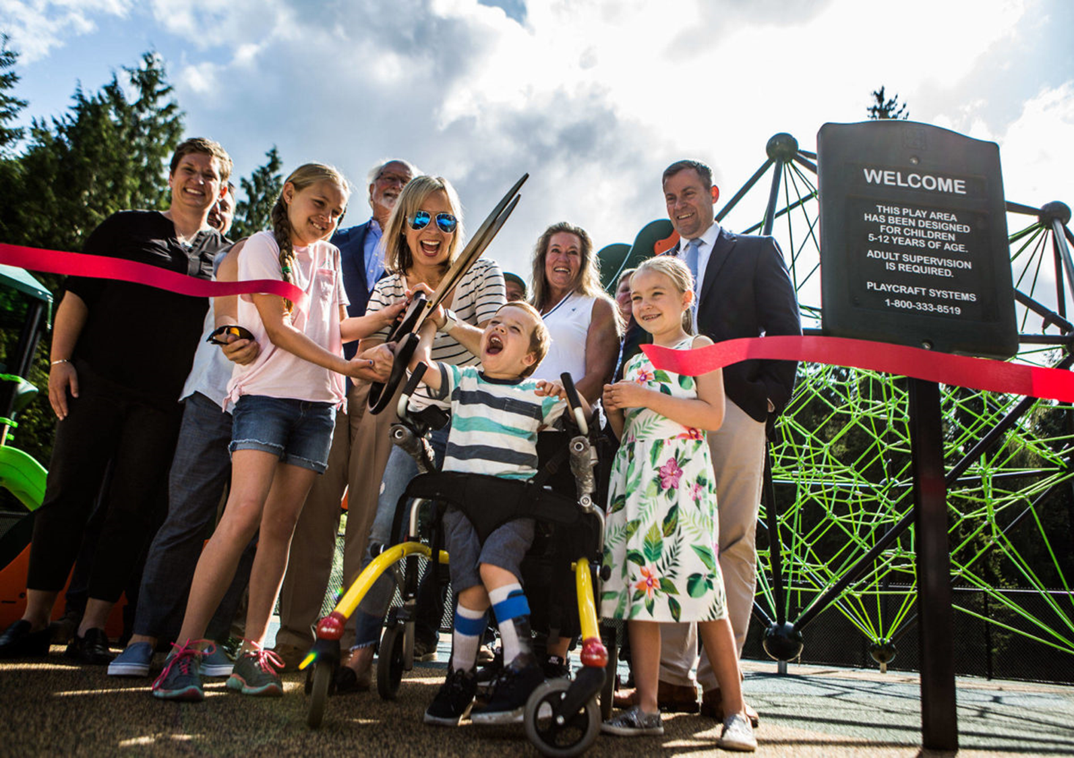
Thank You!

