Slide 2
WHO IS PLAYCRAFT
__________________________
Playcraft Systems is a world class
manufacturer of commercial playground equipment.
Playcraft has been in the business nearly 25 years and is the largest playground manufacturer on the west coast.
Playcraft has secured its reputation as a leader in the industry by building high quality, innovative products with safety, inclusiveness, durability and value as its top priority.
Playcraft is located in beautiful Southern Oregon, where quality of life and a drive for excellence flourishes.
Our State-of-the-Art manufacturing plant is fully integrated and uses the latest environmentally friendly manufacturing technology and materials.

Slide 3
WHY CHOOSE PLAYCRAFT
____________________________
Playcraft Systems is the fastest growing playground manufacturer in the industry, and for good reason.
Our designs are Innovative, Inclusive, Safe and FUN. We have a design for every site and budget.
We’ve got your back through every step of the process and we’ll be there for you on opening day!

Slide 4
PRODUCTS WE OFFER
___________________________
Fully Modular Play Systems
Theme Play Systems
Early Start Play Systems
Freestanding Equipment
Exercraft™ Fitness Equipment
Parkcraft™ Site Amenities
Ground Cover
Replacement Parts

Slide 5
QUALITY
_______________________
We are 100% American made.
Virtually everything that goes into a Playcraft playground is made at our state-of-the-art manufacturing plant guaranteeing supreme quality and attention to detail.
All products meet the requirements set by ASTM, CPSC, and IPEMA. In addition to the industry standards, Playcraft Systems also holds a quality control standard internally. Every component manufactured endures strict scrutiny by our quality control team. All of this in order to provide our customers with the best product on the market that will last for generations to come.

Slide 6
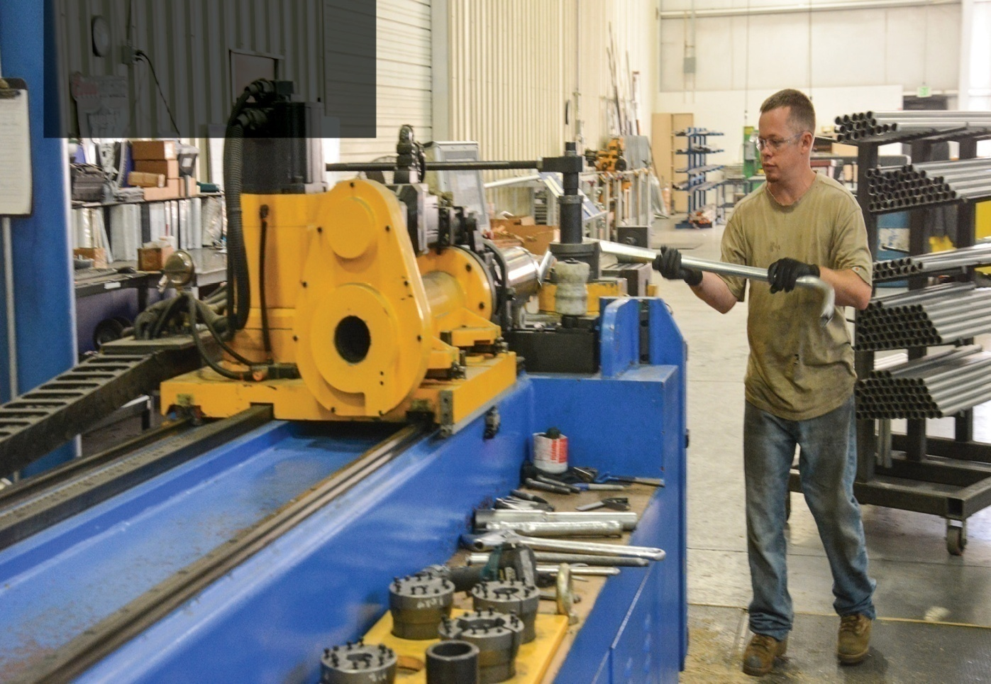
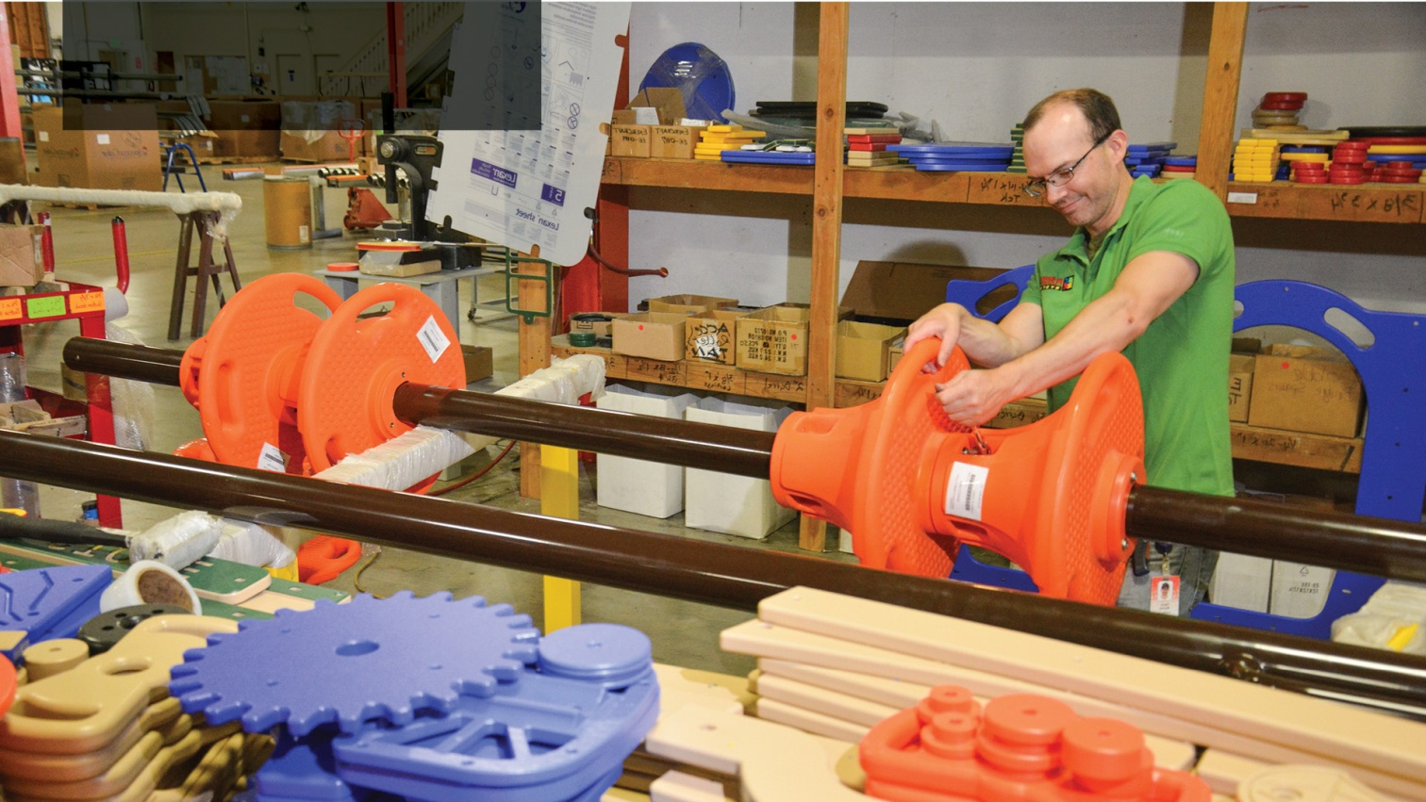
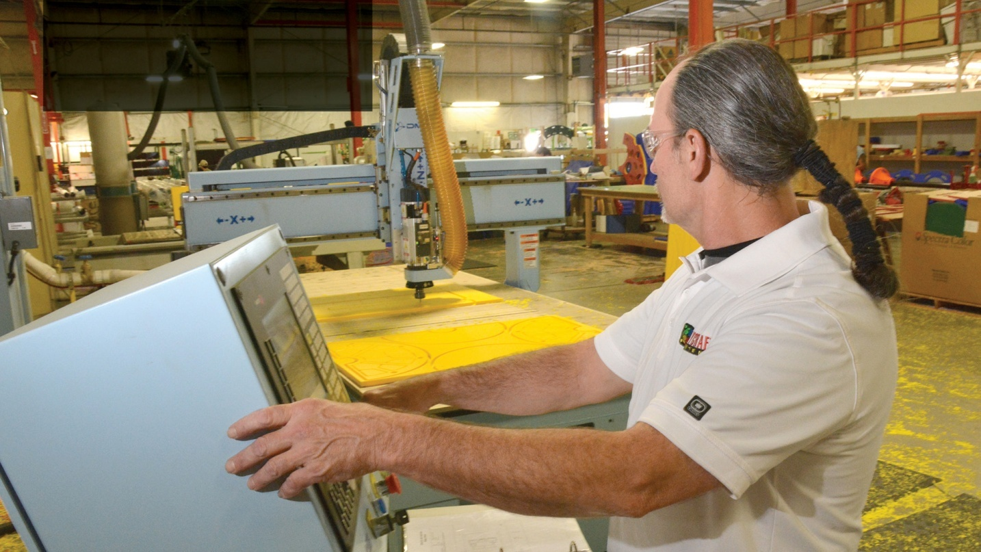
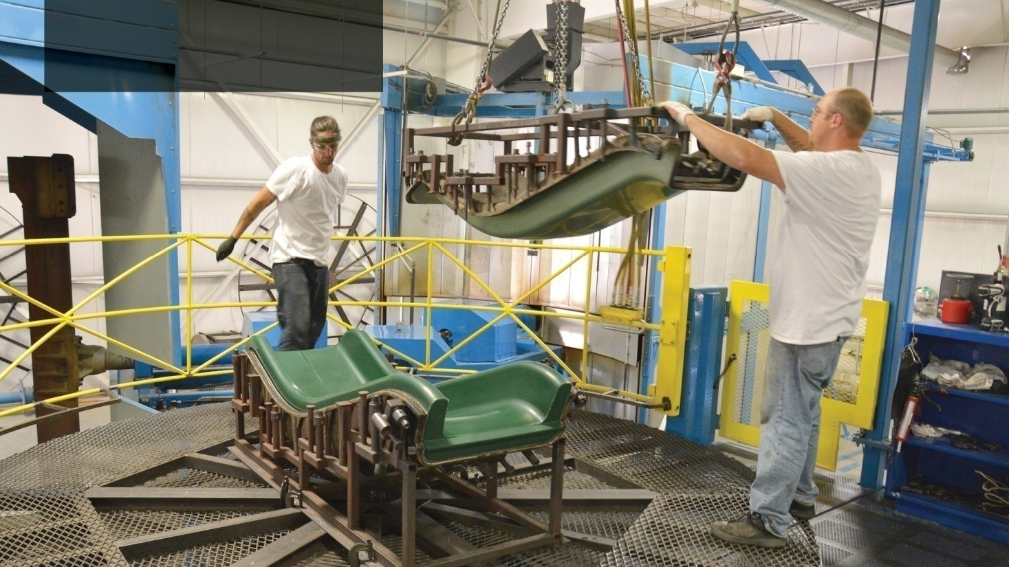
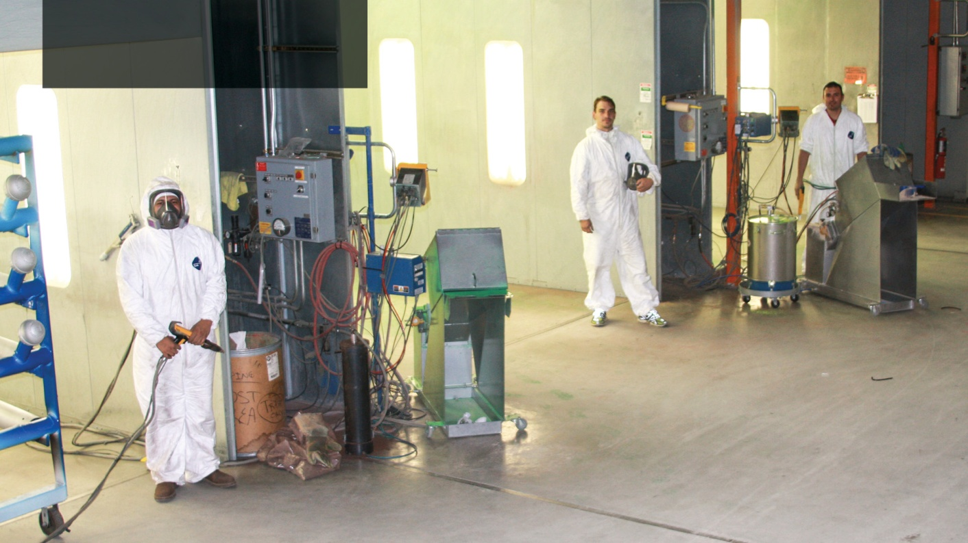
PLAYCRAFT SYSTEMS Headquarters

Slide 7
VERTICALLY INTEGRATED
MANUFACTURING
_________________________
Playcraft Systems is the only manufacturer of playground equipment in the industry to provide all aspects of production. This in-house full vertical integration of manufacturing ensures:
Unequaled Quality
Fast Delivery
Design Flexibility
Unmatched Value

Slide 8
WE ARE INNOVATORS
_________________________
Patented KING CLAMP™ System
Advanced Roto-Molded Plastic Components
Precision Die-Cast Aluminum
Components
Superior Fit and Finish: Thickest Powder-Coatings in the
Industry = Durability
Heavy Duty Perforated Metal Decks made in house with our Play-Tuff™ coating.
Stainless Steel Hardware

Slide 9
SHIPPING EXCELLENCE
_________________________
We guarantee your playground will arrive in excellent condition because we take the same care in packaging as we do in designing and manufacturing.
Custom wood pallets
Box and shrink wrap
Fewer packages

Slide 10
MAINTENANCE
______________________
Maintenance Schedule
Maintenance Kit
Replacement Parts as needed

Slide 11
INDUSTRY LEADING
WARRANTY
_______________________
It is our belief that our products are the finest in the industry and our warranty reflects this! We stand by everything that goes into a Playcraft Systems Playground. We can…. Because we make it all!

Slide 12
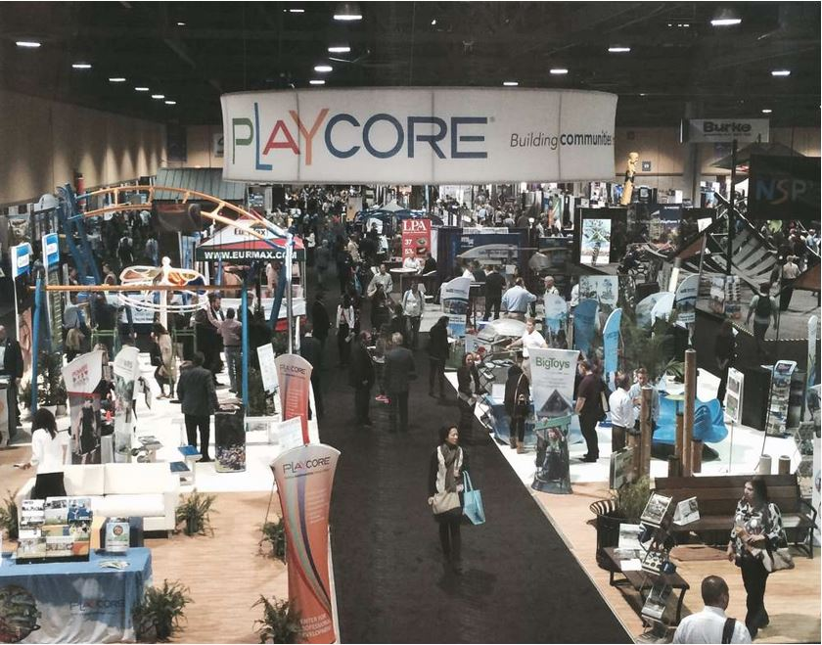
BACKED BY
PLAYCORE
_______________________
Our Mission is building communities through Play & Recreation
Our Values:
Play & Recreation
Leadership
Teamwork
Responsibility
Partnership
Community
CORE
Center for Outreach, Research, & Education
PlayCore Companies:
Dero
GT Grandstands
National Recreation Systems
UltraSite/UltraShade
Porter Corp
Colorado Time Systems
Fountain People
Knorr Systems
Spectrum Aquatics
Water Odyssey
Robertson Recreational Surfaces
Sports Surface Specialties

